Slide 1

Cryptocurrency Price Prediction using LSTM and GRU
Presentation for my Review Paper

Slide 2
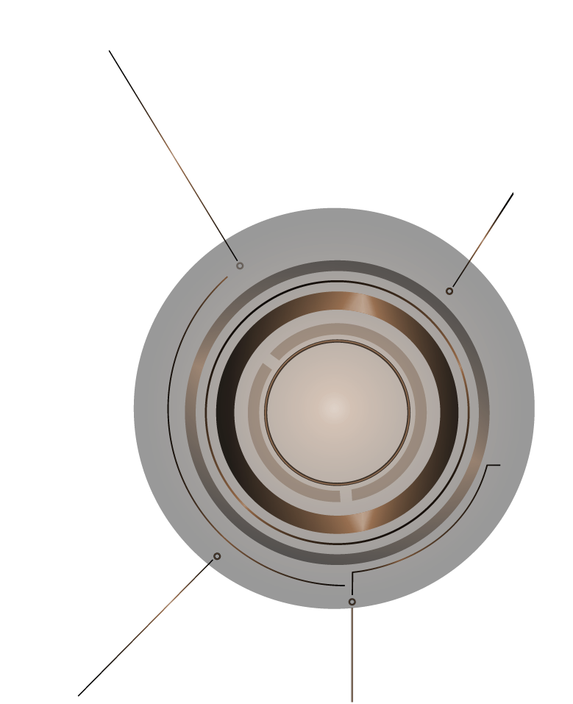
Abstract
Cryptocurrency is the digital form of currency that can be the future currency in the digitalized world.
Our research evaluates LSTM and GRU deep learning models for predicting Bitcoin prices.
Data: Jan 2018 - May 2025 from Bitsmap.
Goal: Achieve high-accuracy time series forecasting.
ML

Slide 3
INTRODUCTION
Crypto gained much influence in 2025 when Donald Trump launched his coin pre-election.
Cryptocurrency is decentralized and secure through Blockchain.
This topic was selected due to its relevance and potential for FYP.
ML

Slide 4
Related Work: Author 1
Paper: 'Machine Learning Models Comparison for Bitcoin Price Prediction' (2018)
Authors: Thearasak Phaladisailoed & Thanisa Numnonda
Models: Theil-Sen, Huber (ML) and LSTM, GRU (DL)
Best Result: GRU (MSE=0.00002, R²=99.2%)
ML

Slide 5
Related Work: Author 2
Paper: 'Bitcoin Price Prediction and Analysis Using Deep Learning Models' (2020)
Author: Muniye Temesgen Awoke Muniye (KIIT University, India)
Models: LSTM and GRU
Best Result: GRU (RMSE=0.075, MAPE=0.065)
ML

Slide 6

Methodology

Slide 7
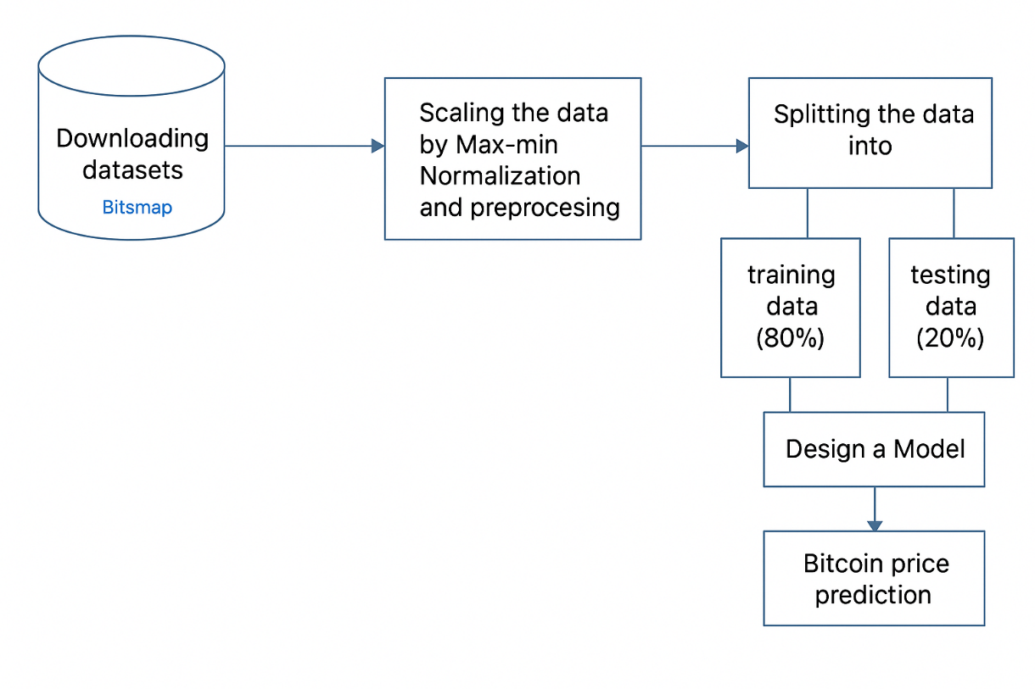
Data: Jan 2018 - May 2025 from Bitsmap.
Preprocessing: Min-max scaling, Z-score for outliers.
Models: LSTM and GRU (RNNs for time series prediction).

Slide 8
LSTM - Long Short-Term Memory
A type of RNN designed to remember long-term dependencies.
Uses input, forget, and output gates to manage memory.
Effective in time series, NLP, and speech tasks.

Slide 9
GRU - Gated Recurrent Unit
Simpler and faster than LSTM, uses reset and update gates.
Fewer parameters, faster training, similar performance.
Efficient for smaller datasets.

Slide 10

FINDINGS

Slide 11
Our models were evaluated using RMSE and R² metrics.
GRU performed better than LSTM.
GRU (RMSE=0.0278, R²=0.9747), LSTM (RMSE=0.0457, R²=0.9313).

Slide 12
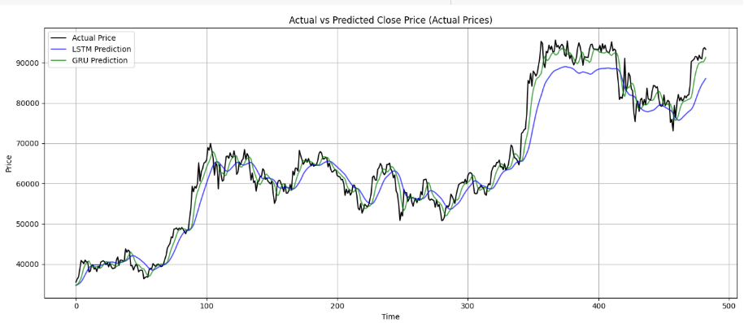
Visuals of our Model

Slide 13
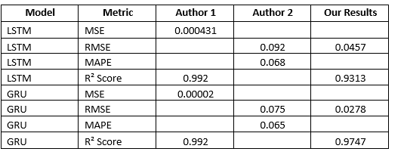
Model Comparison
LSTM - RMSE: Author2=0.092, Ours=0.0457 | R²: Author1=0.992, Ours=0.9313
GRU - RMSE: Author2=0.075, Ours=0.0278 | R²: Author1=0.992, Ours=0.9747
GRU shows better overall performance in all studies.

Slide 14
Conclusion
Cryptocurrency is gaining popularity due to decentralization.
GRU consistently shows better results than LSTM in predicting crypto prices.
Prediction depends on data and regional factors: politics, trends, regulations.

Slide 15
Thanks!
DO YOU HAVE ANY QUESTIONS?

